Slide 1
Programming Fundamentals
Week – 01
by Abeeha Sattar

Slide 2
Nested Function Calls
Calling a function from the body of another function.
float sum (float arr[], int size) {
float sum;
for (int i = 0; i< size; i++)
sum +=arr[i];
return sum;
}
float average(float arr[], int size) {
float avg = sum(arr, size)/size;
return avg;
}
int main() {
float myArr[] = {1,2,3,4,5,6,7,8,9,9.5};
printf("%.2f", average(myArr, 10));
return 0;
}

Slide 3
How is it handled behind the scenes?
The Call Stack!!
It’s used to manage function calls, arguments and local variables.
Before we do anything let’s talk about stacks!

Slide 4
What’s a Stack?
It’s a data structure that operates in a “LIFO” manner (Last-In-First-Out).
It doesn’t allow you to access it’s elements randomly.
You can add or “PUSH” things on top of the stack.
You can remove or “POP” things out of top of the stack.
You can look at or “PEEK” at the top of the stack.
You cannot interact with anything that is not at the top of the stack.
Visualization: https://yongdanielliang.github.io/animation/web/Stack.html

Slide 5
Where is the call stack?
Let’s first see how memory is handled in C.
Command Line Arguments
Stack
(stack expands downwards) ↓ ↑ (heap expands upwards)
Heap
Uninitialized Data (bss)
Initialized Data
Text/Code Segment

Slide 6
Memory Layout of a C Program
Text Segment:
It contains the executable code for the program – functions, and other instructions
Read-Only – you don’t want the function to accidentally get changed during execution
Data Segment:
Contains initialized and uninitialized data segments.
Contains global and static variables.
If a variable is initialized it goes into the initialized data segment, otherwise it goes to the uninitialized one.

Slide 7
Memory Layout of a C Program
Heap Segment:
Dynamically allocated things go here.
We manage memory by using free(), malloc(), realloc(), etc.
Stack Segment:
Stores the local variables, function parameters, return addresses for the function call.
Whenever a function is called, it creates a frame in the stack with all of the above information
Command Line Arguments:
If you run the program using CLI and pass some arguments to the main function, those arguments are stored here.

Slide 8
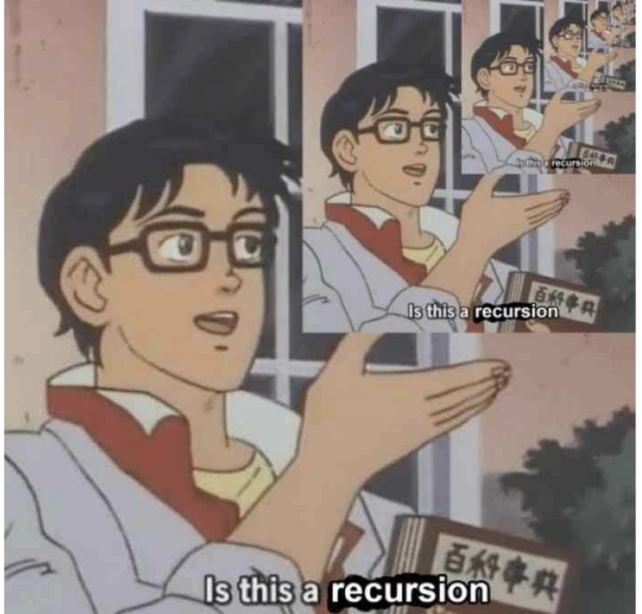
Recursion
A function calling itself is recursion.
void isthisRecursion(){
isthisRecursion();
}
int main () {
isthisRecursion();
}

Slide 9
Example:
The good ol’ factorial:
Calculate the factorial of 5.
5! = ???
5! = 5*4*3*2*1
Or…
5! = 5*4! = 5*4*3! = 5*4*3*2! = 5*4*3*2*1! = 5*4*3*2*1

Slide 10
Factorials contd…
fac(5) = 5*fac(4)
fac(4) = 4*fac(3)
fac(3) = 3*fac(2)
fac(2) = 2*fac(1)
fac(1) = 1
We can generalize it as:
fac(n) = n*fac(n-1) - You always need a stop condition.
We stop when n becomes 1.

Slide 11
Function for Factorial
int factorial( int n) {
if (n==1) // Base case
return 1;
else // Recursive Case
return n * factorial(n-1);
}

Slide 12
Now let’s see how the stack works for this
https://stack-visualizer-wheat.vercel.app/
Stuff is pushed into the stack in this order:
main: fac(5)
fac(5) : 5*fac(4)
fac(4) : 4*fac(3)
fac(3) : 3*fac(2)
fac(2) : 2*fac(1)
fac(1) : 1
Stuff is popped from the stack in the reverse order
receives 120
returns 5*24
returns 4*6
returns 3*2
returns 2*1
returns 1

Slide 13
Try something simple for yourselves:
You can replicate things you have already done with loops, but instead with recursion.
Simplest thing you can try:
Write numbers from 1 to N, where N is provided by the user.
Write the table of N, where N is provided by the user.
Something new, the Fibonacci sequence. In this sequence, the n^{th} term is the sum of its preceding two terms.
0, 1, 1, 2, 3, 5, 8, 13, 21, …
What’s the base case here? What’s the recursive case?

Slide 14
Getting the n^{th} Term in the Sequence
int fibonacci(int num) {
if (num == 1) {
return 0;
} else if (num == 2) {
return 1;
} else {
return fibonacci(num-1) + fibonacci(num-2);
}
}

Slide 15
Let’s print the sequence recursively
void printFibonacci(int n, int a, int b) {
if (n == 0) //base case
return ;
printf("%d ", a);
printFibonacci(n - 1, b, a + b); //recursive call
}

Slide 16
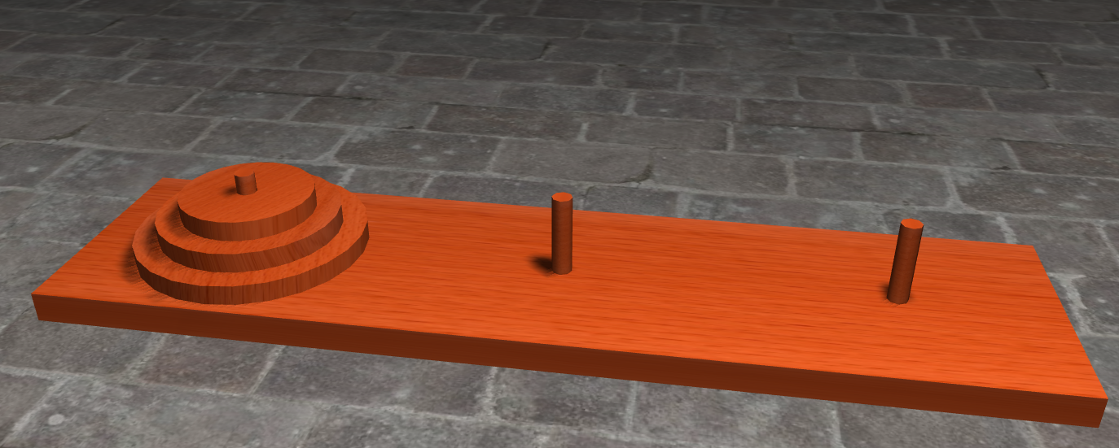
Now one of the Classic Problems… Towers of Hanoi
https://towersofhanoi.info/Animate.aspx

Slide 17
Rules for the Game
The goal is to move every disk from the first peg(source) to the second peg(destination) while having the third peg as a spare/auxiliary/temporary.
Move only one disk at a time
Move only the top disk from a stack
Never place a larger disk on top of a smaller disk

Slide 18
Let’s work on the logic for this
How do we move everything from source peg to destination peg?
If you can somehow move all but one disk from source peg to spare peg, we can move the remaining disk from source to destination.
Now whatever is left on the spare peg, we can move it to the destination peg.
… but how? By repeating the same steps again…
Now the spare is the new source and destination is still the destination, and source is the new spare.
We have to keep repeating this until everything is on the destination peg.

Slide 19
Logic:
Let n be the number of disks that we want to move from source peg to destination peg using the spare peg. Then:
Move n-1 disks from source to spare, using destination as a “spare”
Move the 1 disk left on source to destination
Move the n-1 disks from spare (acts as source now) to destination, using source (acts as spare now)

Slide 20
Let’s Program This…
void hanoi (int num, char src, char dest, char temp){
if (num == 0) {
return; //base case
} else {
hanoi(num-1, src, temp, dest);
printf ("Move disk %d from %c to %c\n", num, src, dest);
hanoi(num-1, dest, temp, src);
}
}

Slide 21
Fin.

